Slide 1
California Standards
Group 3 Chapter 3 By Brittany Wray and Katya Prupis
6.3.1 Describe the origins and significance of Judaism as the first monotheistic religion based on the concept of one God who sets down moral laws for humanity.
6.3.2 Identify the sources of the ethical teachings and central beliefs of Judaism: belief in God, observance of law, practice of the concepts of righteousness and justice and the importance of study; and describe how the ideas of the Hebrew traditions are reflected in the moral and ethical traditions of Western civilization.
6.3.3 Explain the significance of Abraham, Moses, Naomi, Ruth, David, and Yohanan ben Zaccai in the development of the Jewish religion.
6.3.4 Discuss the locations of the settlements and movements of Hebrew peoples, including the Exodus and their movement to and from Egypt, and outline the significance of the Exodus to the Jewish and other people.
6.3.5 Discuss how Judaism survived and developed despite the continuing dispersion of much of the Jewish population from Jerusalem and the rest of Israel after the destruction of the second Temple in A.D. 70.

Slide 2
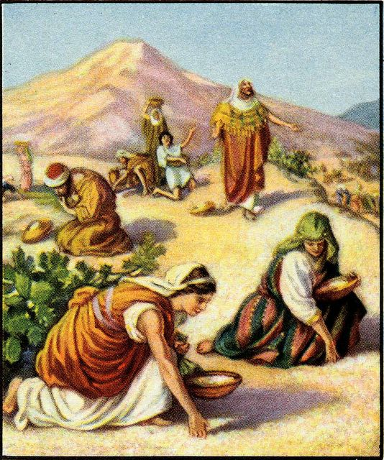
The First Israelites
1400 B.C. – 1000 B.C.
Brittany Wray

Slide 3
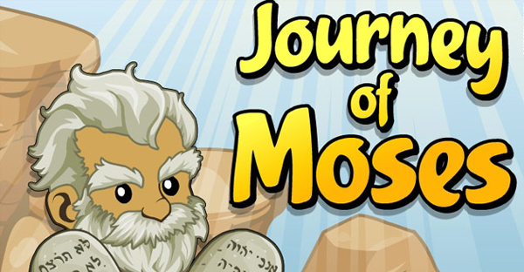
Get Ready to Learn!
Vocabulary
Important People
Monotheism
Belief in one God
Tribe
Separate family group
Torah
Laws Moses received from God
Covenant
An agreement
Alphabet
Group of letters that stand for sounds
Abraham
Jacob
Moses
Deborah
Phoenician

Slide 4
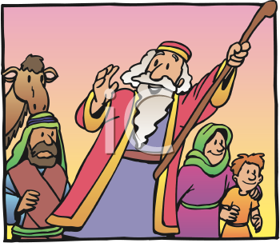
What’s the Connection?
Egyptians built a great civilization
During this time another nation was forming
These people were called Israelites
Also known as the Children of Israel
Egyptians called them habiru or foreigners

Slide 5
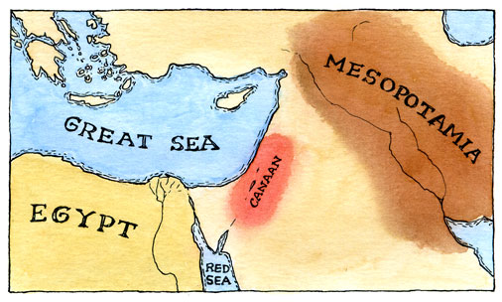
The Early Israelites
1000 B.C.
Israelites (IHZ – ruh – LYTS)
Kingdom in Canaan (KAY – nuhn)
Located along the Mediterranean Sea in southwest Asia

Slide 6
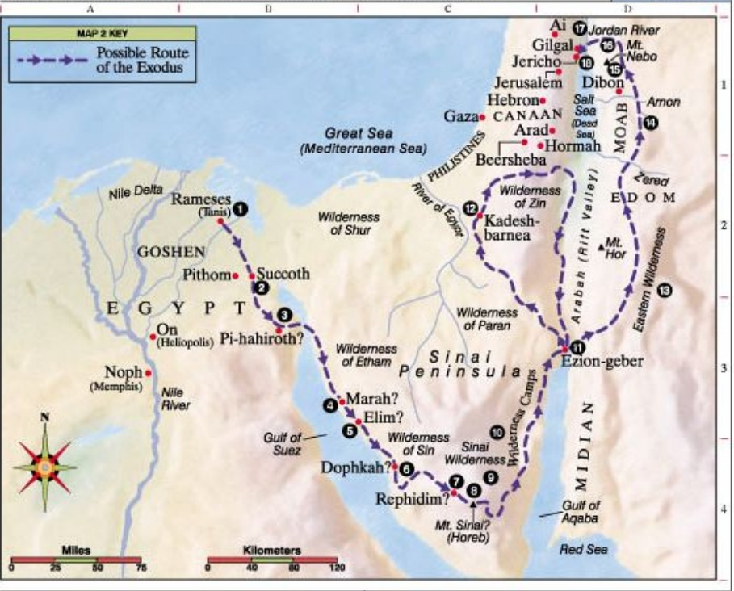

Slide 7
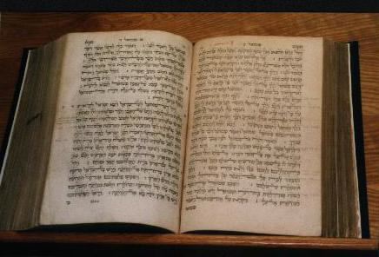
Who Were the Israelites?
Monotheism
The belief in one God
Practiced Judaism
Followers of this religion were known as Jews
Influenced Christianity and Islam
Spoke Hebrew
Hebrew Bible
Herders & Traders

Slide 8
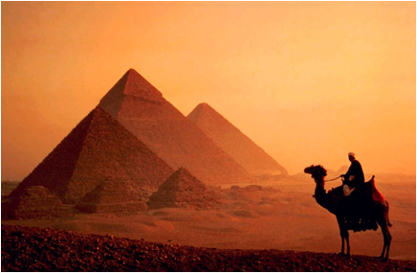
Who Were the Israelites?
Abraham
Messages from God
Reason for settling in Canaan
Jacob
Abraham’s grandson “Israel”
Raised twelve sons
Family divided into tribes
Long drought
No crops or livestock
Israelites traveled to Egypt

Slide 9
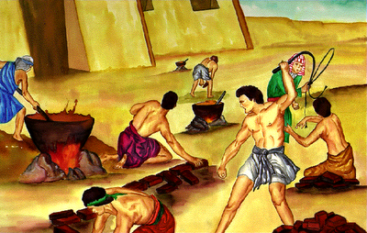
Slavery in Egypt
Pharaoh’s pyramids
Enslaved Israelites
Baby boys thrown in Nile
Baby in a basket: Moses
1290 B.C.
Burning Bush & voice
God’s message
Ten plagues
Last plague killed all first born children
Pharaoh let Israelites leave
Passover

Slide 10
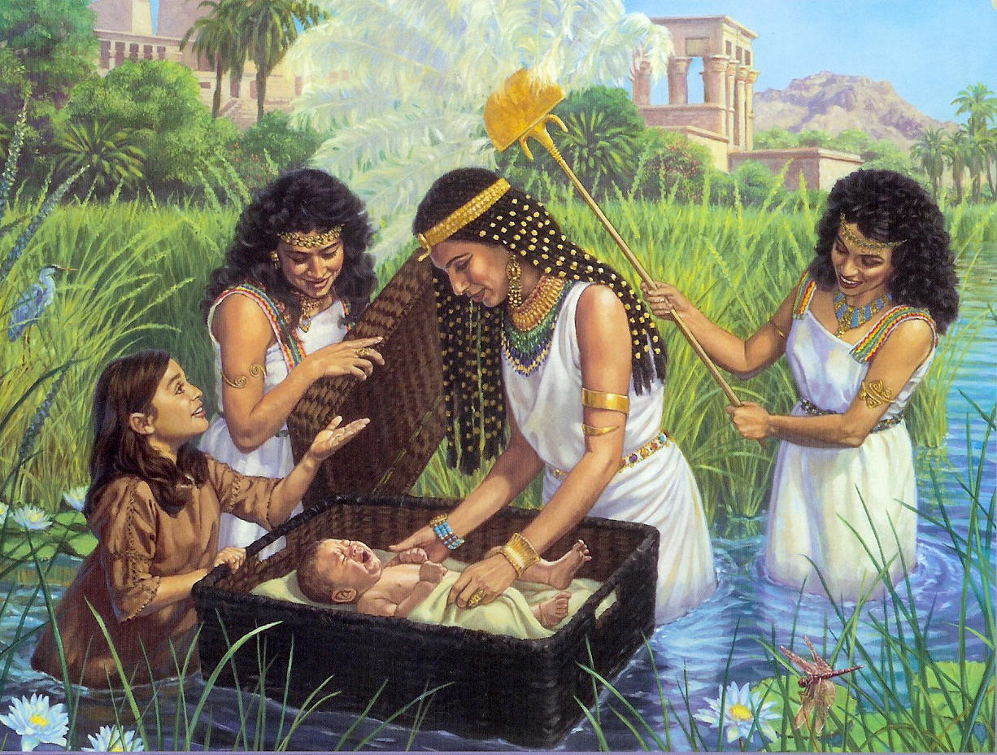

Slide 11
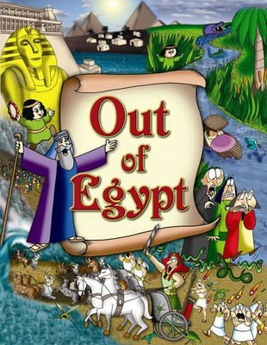
The Red Sea
Israelites headed east
Pharaoh sent army
God parted the Red Sea
Water drowned Egyptian soldiers
Israelite escape: Exodus

Slide 12
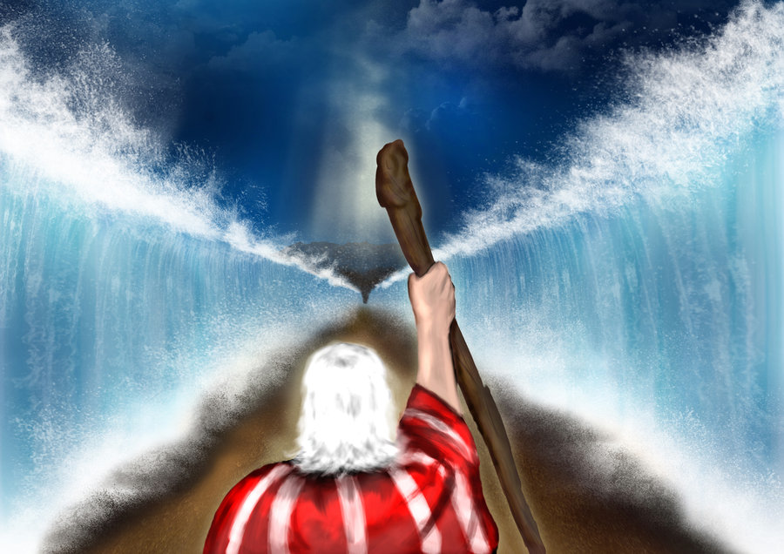

Slide 13
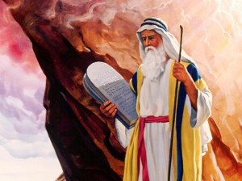
Back to Canaan
Sinai Desert
Moses went to top of Mount Sinai (SY – NY)
Received laws from God
Also known as the Torah
Described a covenant
Right & wrong

Slide 14
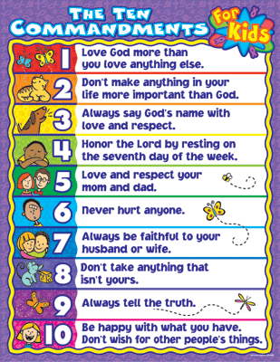
Back to Canaan
Ten Commandments
Loyal only to one God
Shaped basic moral laws
Do not steal, murder, or lie
Avoid jealousy
Honor parents
“Rule of Law”

Slide 15
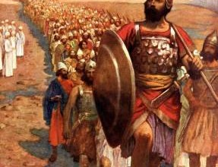
Back to Canaan
The Promised Land
40 years later
Moses died & Joshua took over
Occupied by Canaanites (KAY – nuh – NYTS)
Joshua led them into battle
Jericho
City walls crumbled
Three more wars
Land divided among twelve tribes

Slide 16
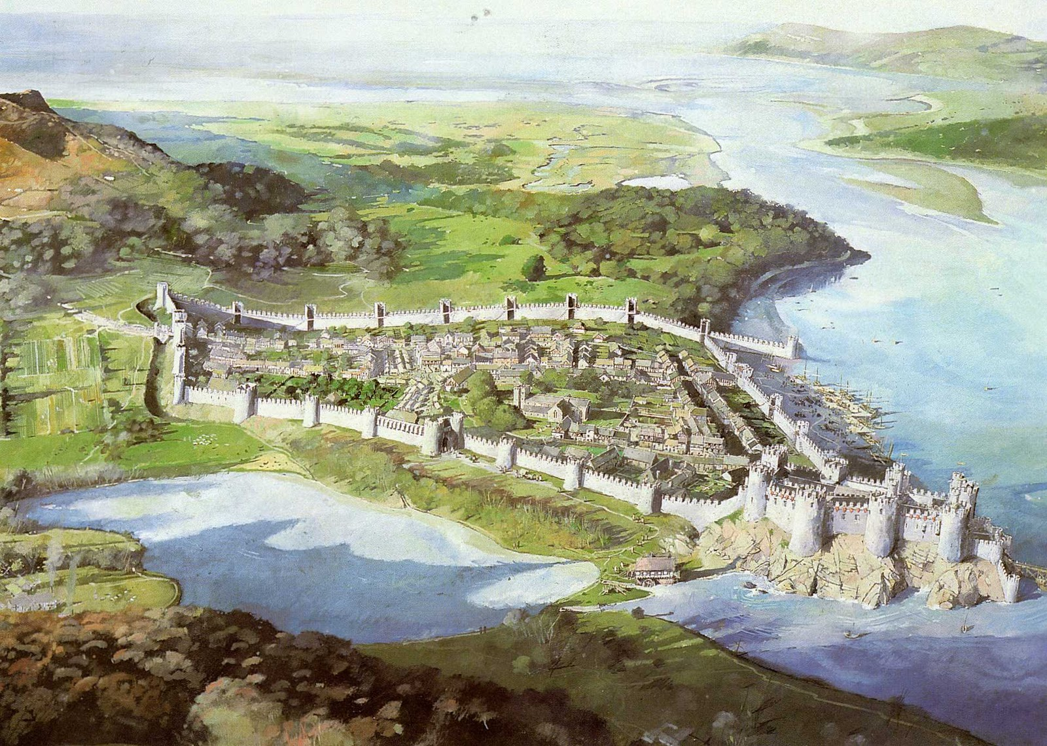
Who Were the Fighting Judges?
Joshua died
Israelites looked to Judges for leadership
Military leader
1 or 2 tribes
Deborah
Woman judge
1125 B.C. helped destroy King Jabin and army
Israelites won control of hilly region
Built walled towns
Canaanites kept flat, coastal areas

Slide 17
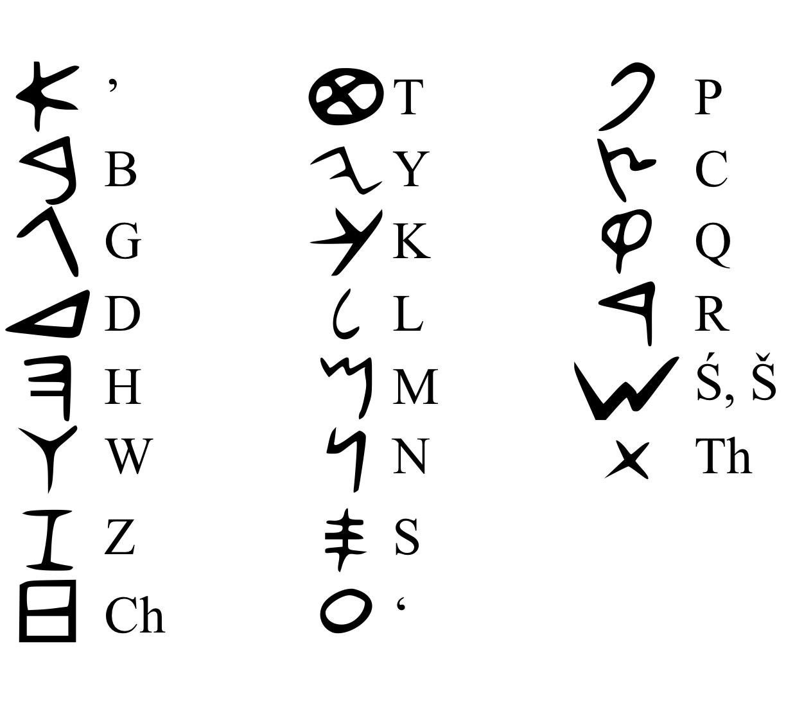
The Phoenician Alphabet
Phoenicians
One group of Canaanites
Lived along Mediterranean Sea
Skilled sailors and traders
Spread ideas & goods
Alphabet
One of the most important ideas
Made writing simpler
Helped keep records
Phoenicians -> Greeks -> Romans

Slide 18
Study Central
Online review, main ideas, building vocabulary, notes, web links, and quiz!
http://www.glencoe.com/apps/studycentral/0078688736/core_content.html

